Slide 1
F1TENTH @ IROS2020 Orientation
F1TENTH Team
September 2, 2020

Slide 2
Communicating with the F1TENTH team
Join our slack workspace here: https://join.slack.com/t/f1tenth-teams/shared_invite/enQtMzc3ODU2ODM1NzE3LTBjMmVkMzZjZTJiNWUzZDFhZTJiODgzMjg0MTA1MDAxZTUxMzkwMDRhNTM2NzdjNDc5MTk5YTc5YmNhNTdhMTU
Post in the #iros2020 channel
Notes:
kim

Slide 3
Agenda
Overview
Event Logistics
Simulation Environment
Rules and Regulations
Notes:
mok

Slide 4
Overview
Notes:
Mok

Slide 5
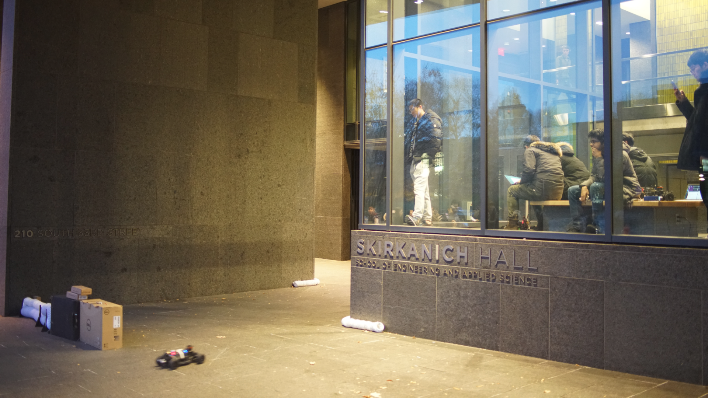
Notes:
mok

Slide 6
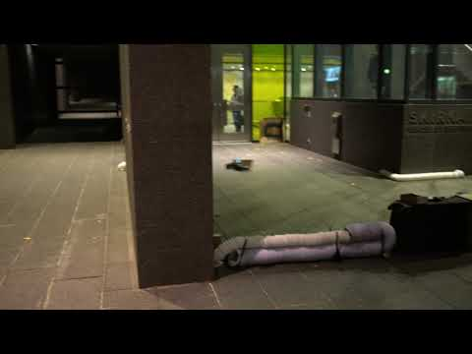
Notes:
mok

Slide 7
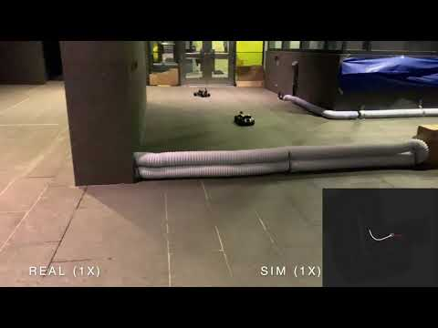
From real to virtual races
The F1TENTH development team has created an empirically validated simulation environment.
We have used this simulator for multiple internal research projects and two semesters of class.
Notes:
mok

Slide 8
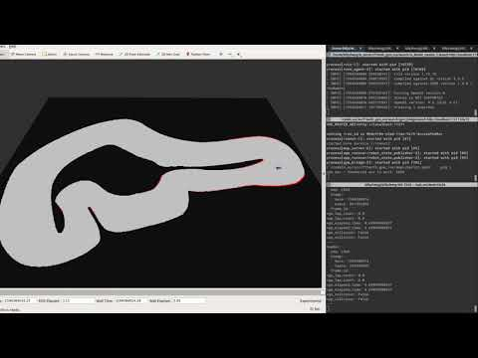
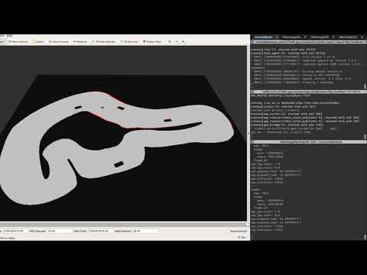
IFAC Qualifying Highlights

Slide 9

HiPeRT Modena vs. VandyCPS
Notes:
Modena vs. Vandy… great overtake
Modena advances

Slide 10
Event Logistics
Notes:
Mok

Slide 11
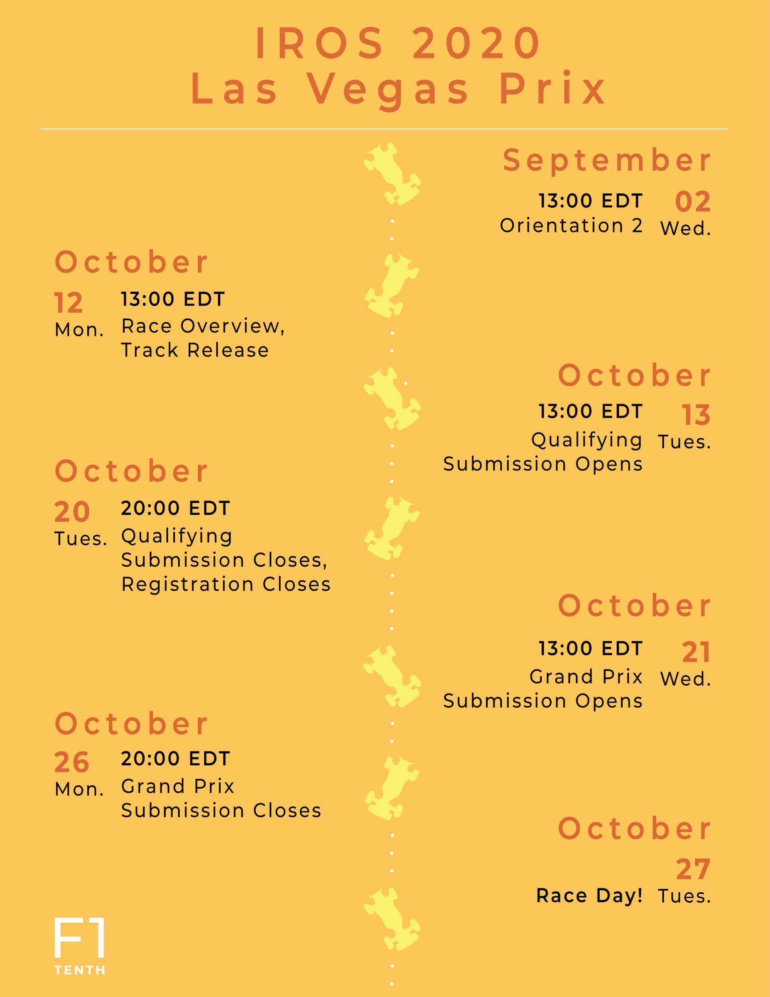
Schedule
Notes:
kim

Slide 12
Phases Overview
Qualifying (single agent)
Timed trials without obstacles
Obstacle avoidance test
Must pass in order to move to Grand Prix Phase
Grand Prix (multi agent)
Finish 2 laps before the other agent.
Same map for both phases
Notes:
kim

Slide 13
Benchmark Overview
Benchmark 1 (Qualifying) is a single agent time trial without obstacle on the track. The objective is to achieve lower lap times.
Benchmark 2 is a single agent task with unknown obstacles in the map before hand. The objective is to finish laps without crashing.
Must pass in order to move to Grand Prix Phase
Benchmark 3 is a task where two agents compete simultaneously on the same track. The objective is to finish a certain number of laps before the other agent.

Slide 14
Phase 1: Qualifying
The same submission needs to be able to
compete in a timed trial on the map without any obstacles, and
finish the laps without collision in the same map with obstacles that are unknown prior to run time.
A live leaderboard will be maintained to show the lap times, and a table will also show the result of the obstacle avoidance task (pass or fail). https://iros2020.f1tenth.org/
Notes:
Obs avoid map: 1 out of 5~10 maps will be randomly selected. Participants gets feedback on p/f, also sees a gif of the rollout (if billy can’t finish this on time then they get the map)
Link is not currently live right now

Slide 15




Phase 1: Qualifying
Finish the laps in the shortest time possible without collision in the same map with obstacles that are unknown prior to run time.
Base Map
Level 1
Level 2
Level 3
Notes:
Obs avoid map: 1 out of 5~10 maps will be randomly selected. Participants gets feedback on p/f, also sees a gif of the rollout (if billy can’t finish this on time then they get the map)

Slide 16
Phase 1: Qualifying
The results of this phase will be used to seed the Grand Prix.
The brackets will be posted at https://iros2020.f1tenth.org/
Notes:
kim

Slide 17
Phase 1: Qualifying - Submission
Requirements:
Submit Docker image via DockerHub
Unique submission passcode assigned to you
README
Submission portal is at https://iros2020.f1tenth.org/
Make sure you are registered.
DEADLINE: OCTOBER 20 at 20:00 EDT
Notes:
Q: what if i don’t want my github repo to be public
A: You can create a docker image/container that only includes the binary of your source code and make sure to provide the proper launch command, and proper communication between your container and the provided sim container. Note that you’ll still provide us with a git repo link, but probably with just a bash script in it to execute whatever command you want.

Slide 18
Phase 2: Grand Prix
A head to head tournament seeded by Phase 1 results.
Only submissions that passed the obstacle avoidance test will be able to participate in the tournament.
The map for the Grand Prix will be the same for Qualifying.
Objective is to finish 2 laps before the other agent
Notes:
To determine who finished before the other, we will be checking the /race_info topic, which has a lap count, and an elapsed time for both agents. Finishing before the other agent means that for the same lap count you elapsed time is lower.
We will do two rollouts for each bracket -> switching the starting position

Slide 19
Phase 2: Grand Prix - Submission
Requirements:
Submit Docker image via DockerHub
Unique submission passcode assigned to you
README
Submission portal is at https://iros2020.f1tenth.org/
DEADLINE: OCTOBER 26 at 20:00 EDT
Notes:
(same as phase one submission)

Slide 20
Race Day
Competition will be streamed live at https://iros2020.f1tenth.org/ and https://twitch.com/f1tenth
Streaming schedule will be posted beforehand.
Time for race day TBD
OCTOBER 27

Slide 21
Podium Ceremony
TBD? Still working with IROS coordinators on this
Hoping to get similar amount in awards if not better

Slide 22
Simulation Environment
Notes:
Mok

Slide 23
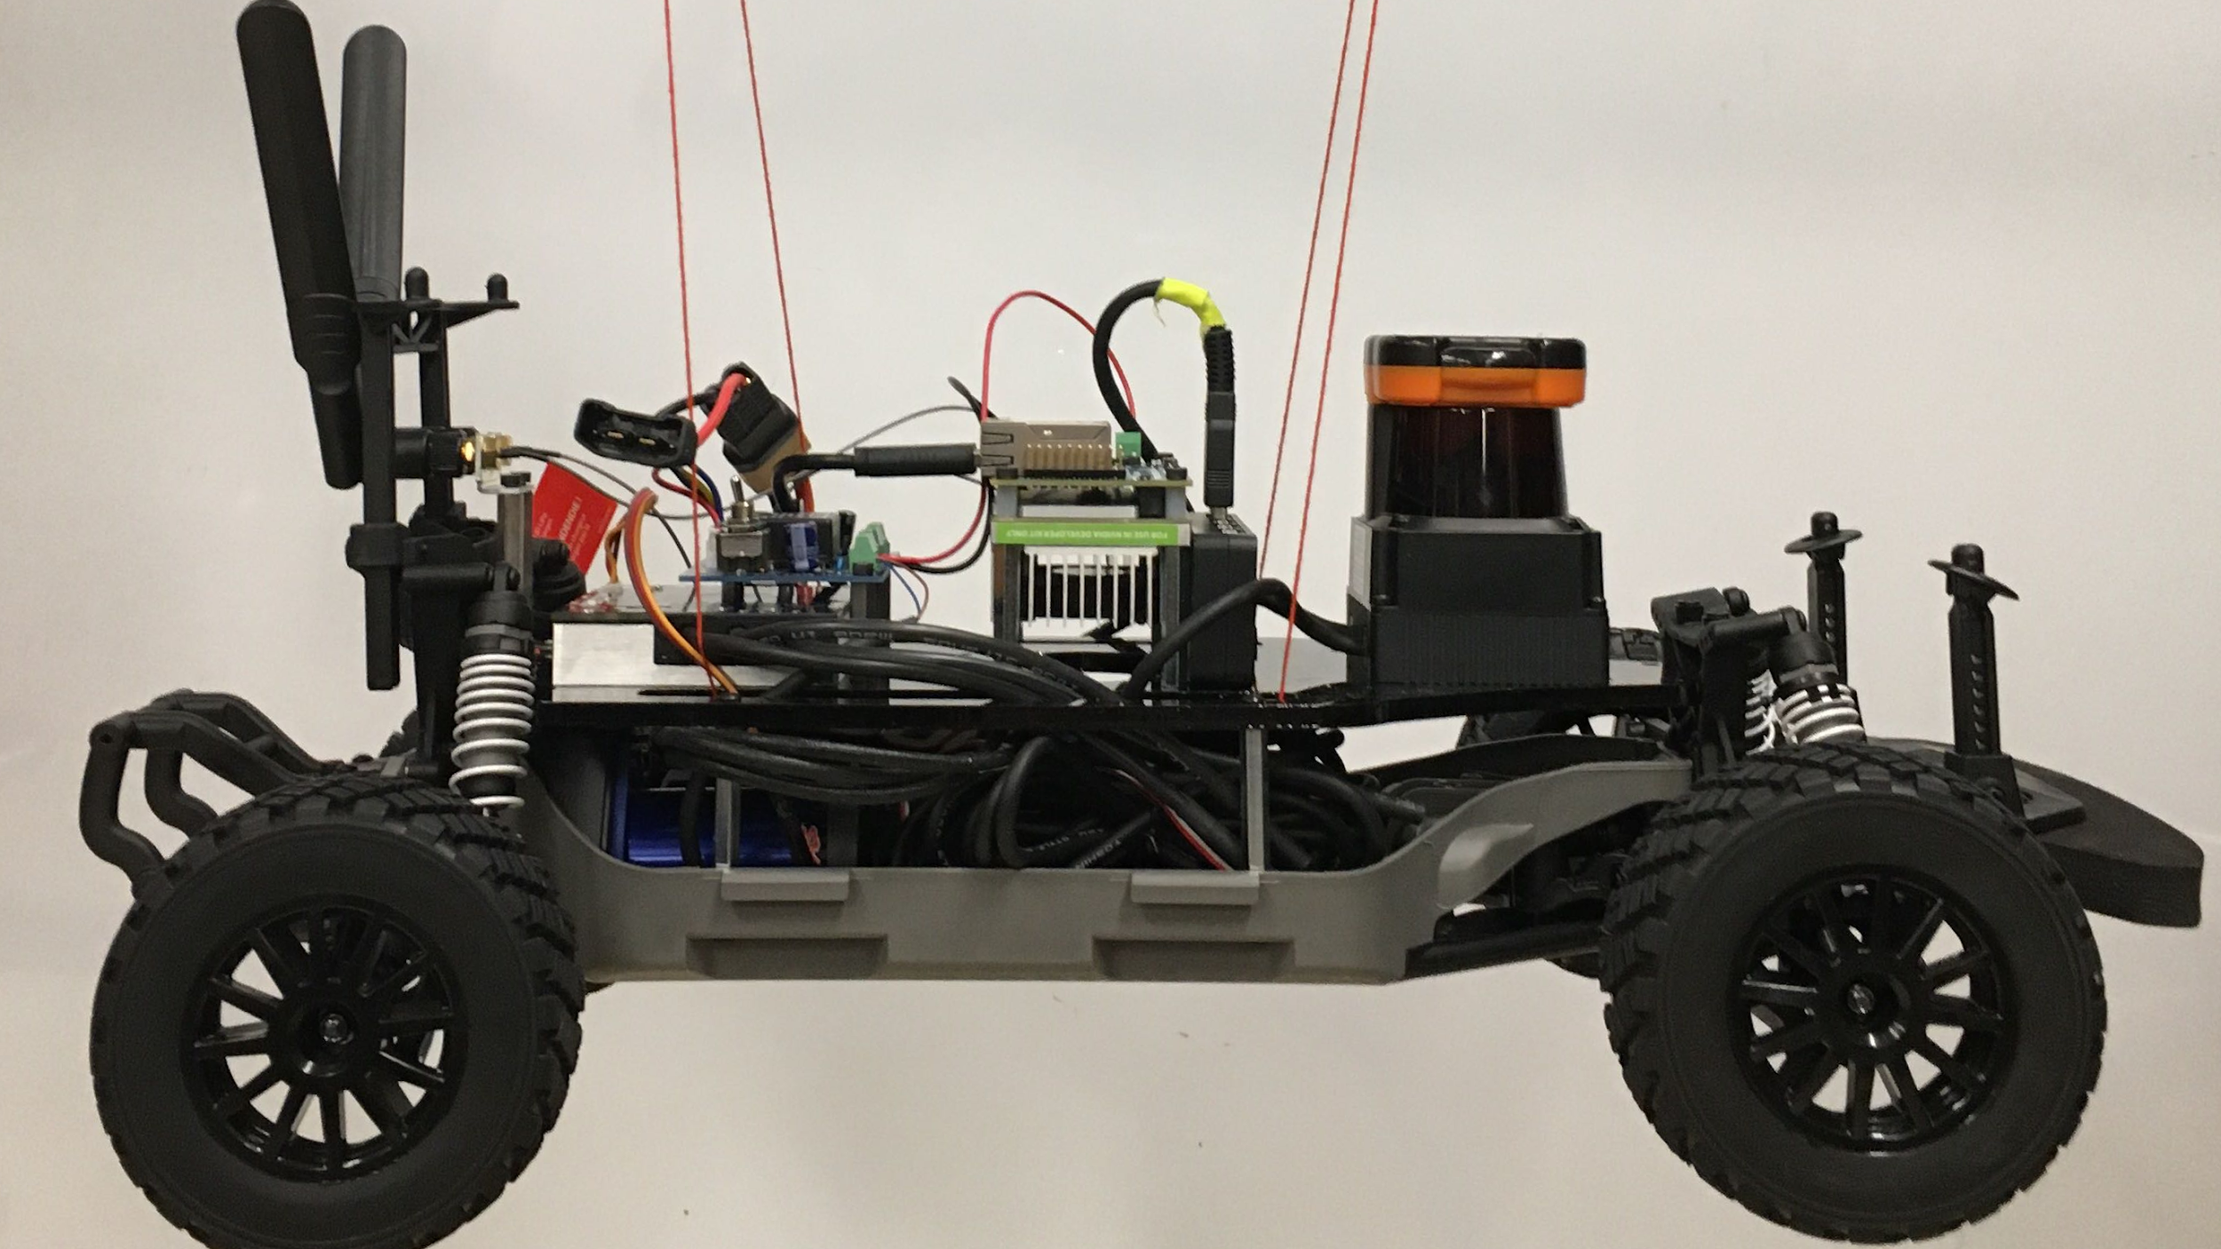
Notes:
Billy… just say something about how we did sysid and stuff… this is sort of how we did it/why its good

Slide 24
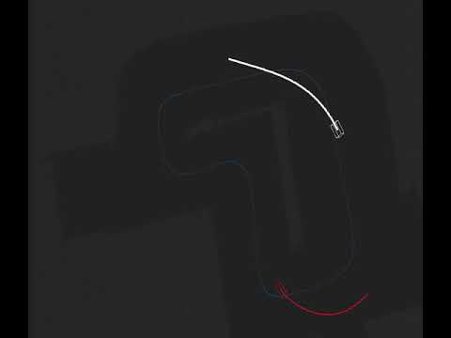
Simulator Features
The simulator supports:
Importation of occupancy grid maps
ROS and OpenAI Gym interfaces.
Single car and two car racing
Notes:
Billy

Slide 25
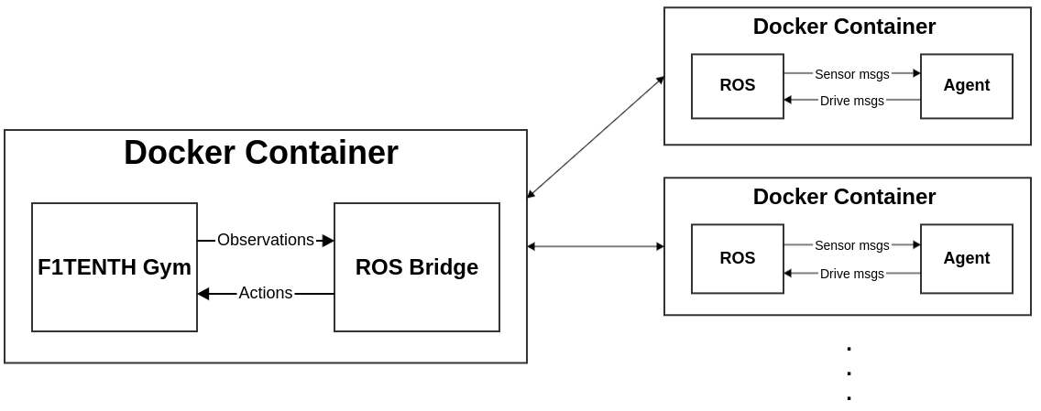
F1TENTH Gym Overview
This is where you interact with the sim
Notes:
billy

Slide 26
Installation
Follow the README and install the F1TENTH gym https://github.com/f1tenth/f1tenth_gym_ros.
Two branches for different testing in different phases: master for the qualifying phase, multi_node for grand prix phase.
Make sure you follow the readme to start developing
Will have an announcement/tutorial soon on how to develop an agent docker image
Notes:
billy

Slide 27
Available topics for subscription
/scan and /odom: the ego agent’s sensor information
/opp_scan and /opp_odom: the opponent agent’s information. Note that you don’t have to detect and track the opponent car from the laser scan, the odometry of the opponent car is provided.
/map and /race_info: the map of the simulation, and information of the race (both agent’s elapsed runtimes, lap counts, and collisions)

Slide 28
Publishing drive messages
On the master branch for single agent simulation, publish your drive message on the /drive topic using the AckermannDriveStamped message type.
On the multi_node branch for two-agent simulation, publish the ego agent's drive commands to /drive, and the opponent agent's drive commands to /opp_drive. At this point, we're not providing any agents built in for testing.

Slide 29
Collision
Currently, the cars will stop when in collision with the environment, but will keep moving when in collision with each other.
Collision should be checked through the /race_info topic.

Slide 30
Development Tips
Create another agent to compete against your agent to mimic the grand prix
Create your own map with unknown obstacles
There are two branches that you could use to test your agents. (master for qualifying phase, multi_node for grand prix phase)
Notes:
billy

Slide 31
Rules and Regulations
Notes:
Mok

Slide 32
Rules and FAQs
Can always be found in guidelines:
https://docs.google.com/document/d/1XOC3AQzqjezTwQeF7hDRF2Z49TIg-dn12xCkKPwGLYg/edit
FAQ will be updated to include questions from slack as we receive and answer them

Slide 33
Rules - General
The map used for all evaluation tasks will be the same (the map for the obstacle avoidance task will have added obstacles).
All evaluations will be two laps.
F1TENTH reserves the right to reject any submission that we deem illegal due to circumstances such as exploiting the simulation environment.
F1TENTH reserves the right to assign blame in the case of agent collision in the head to head tournament. The justification will follow section 4 of the rules.
Notes:
mok/billy

Slide 34
Rules - Qualifying Phase
Timed Trials
If an agent can finish without collision with the environment, it’ll receive a lap time and update its ranking on the leaderboard.
Obstacle Avoidance
The location and the size of the obstacles will not be revealed prior to submission. Some example maps with obstacles will be provided.
Notes:
mok/billy

Slide 35
Rules - Grand Prix Phase
Seeding
The elimination bracket of the tournament will be filled by submissions that passed the obstacle avoidance test and seeded by the result of the timed trials. For example, with 8 teams, the bracket of the first round will be (#1 vs. #8, #2 vs. #7, #3 vs. #6, and #4 vs. #5).
Overtaking, car control and collisions
Overtaking, according to the circumstances, may be carried out on either the right or the left. Manoeuvres liable to hinder other drivers, such as deliberate crowding of a car beyond the edge of the track or any other abnormal change of direction, are strictly prohibited. The stewards will have the final say in whether a driver is in violation of the rule.
Causing a collision (decided by the stewards) for more than 3 times will result in automatic disqualification.
The stewards reserve the right to assign blame to both agents in some cases of collisions. In this case, both participants lose a chance to cause a collision (out of 3 times).
Notes:
mok/billy

Slide 36
Questions?
Notes:
Mok

